Slide 1
Strenghtening multilevel governance in national energy and climate policies by implementing dialogue platforms in 6 European countries

Slide 2

The NECPlatform project
will support 6 EU Member States in setting up and managing multi-level dialogue platforms, as mandated by Article 11 of the Climate & Energy Governance Regulation, to foster vertical and horizontal integration of national energy and climate policies.
Playing solo might be easier and quicker, but playing together
makes a much nicer symphony!

Slide 3
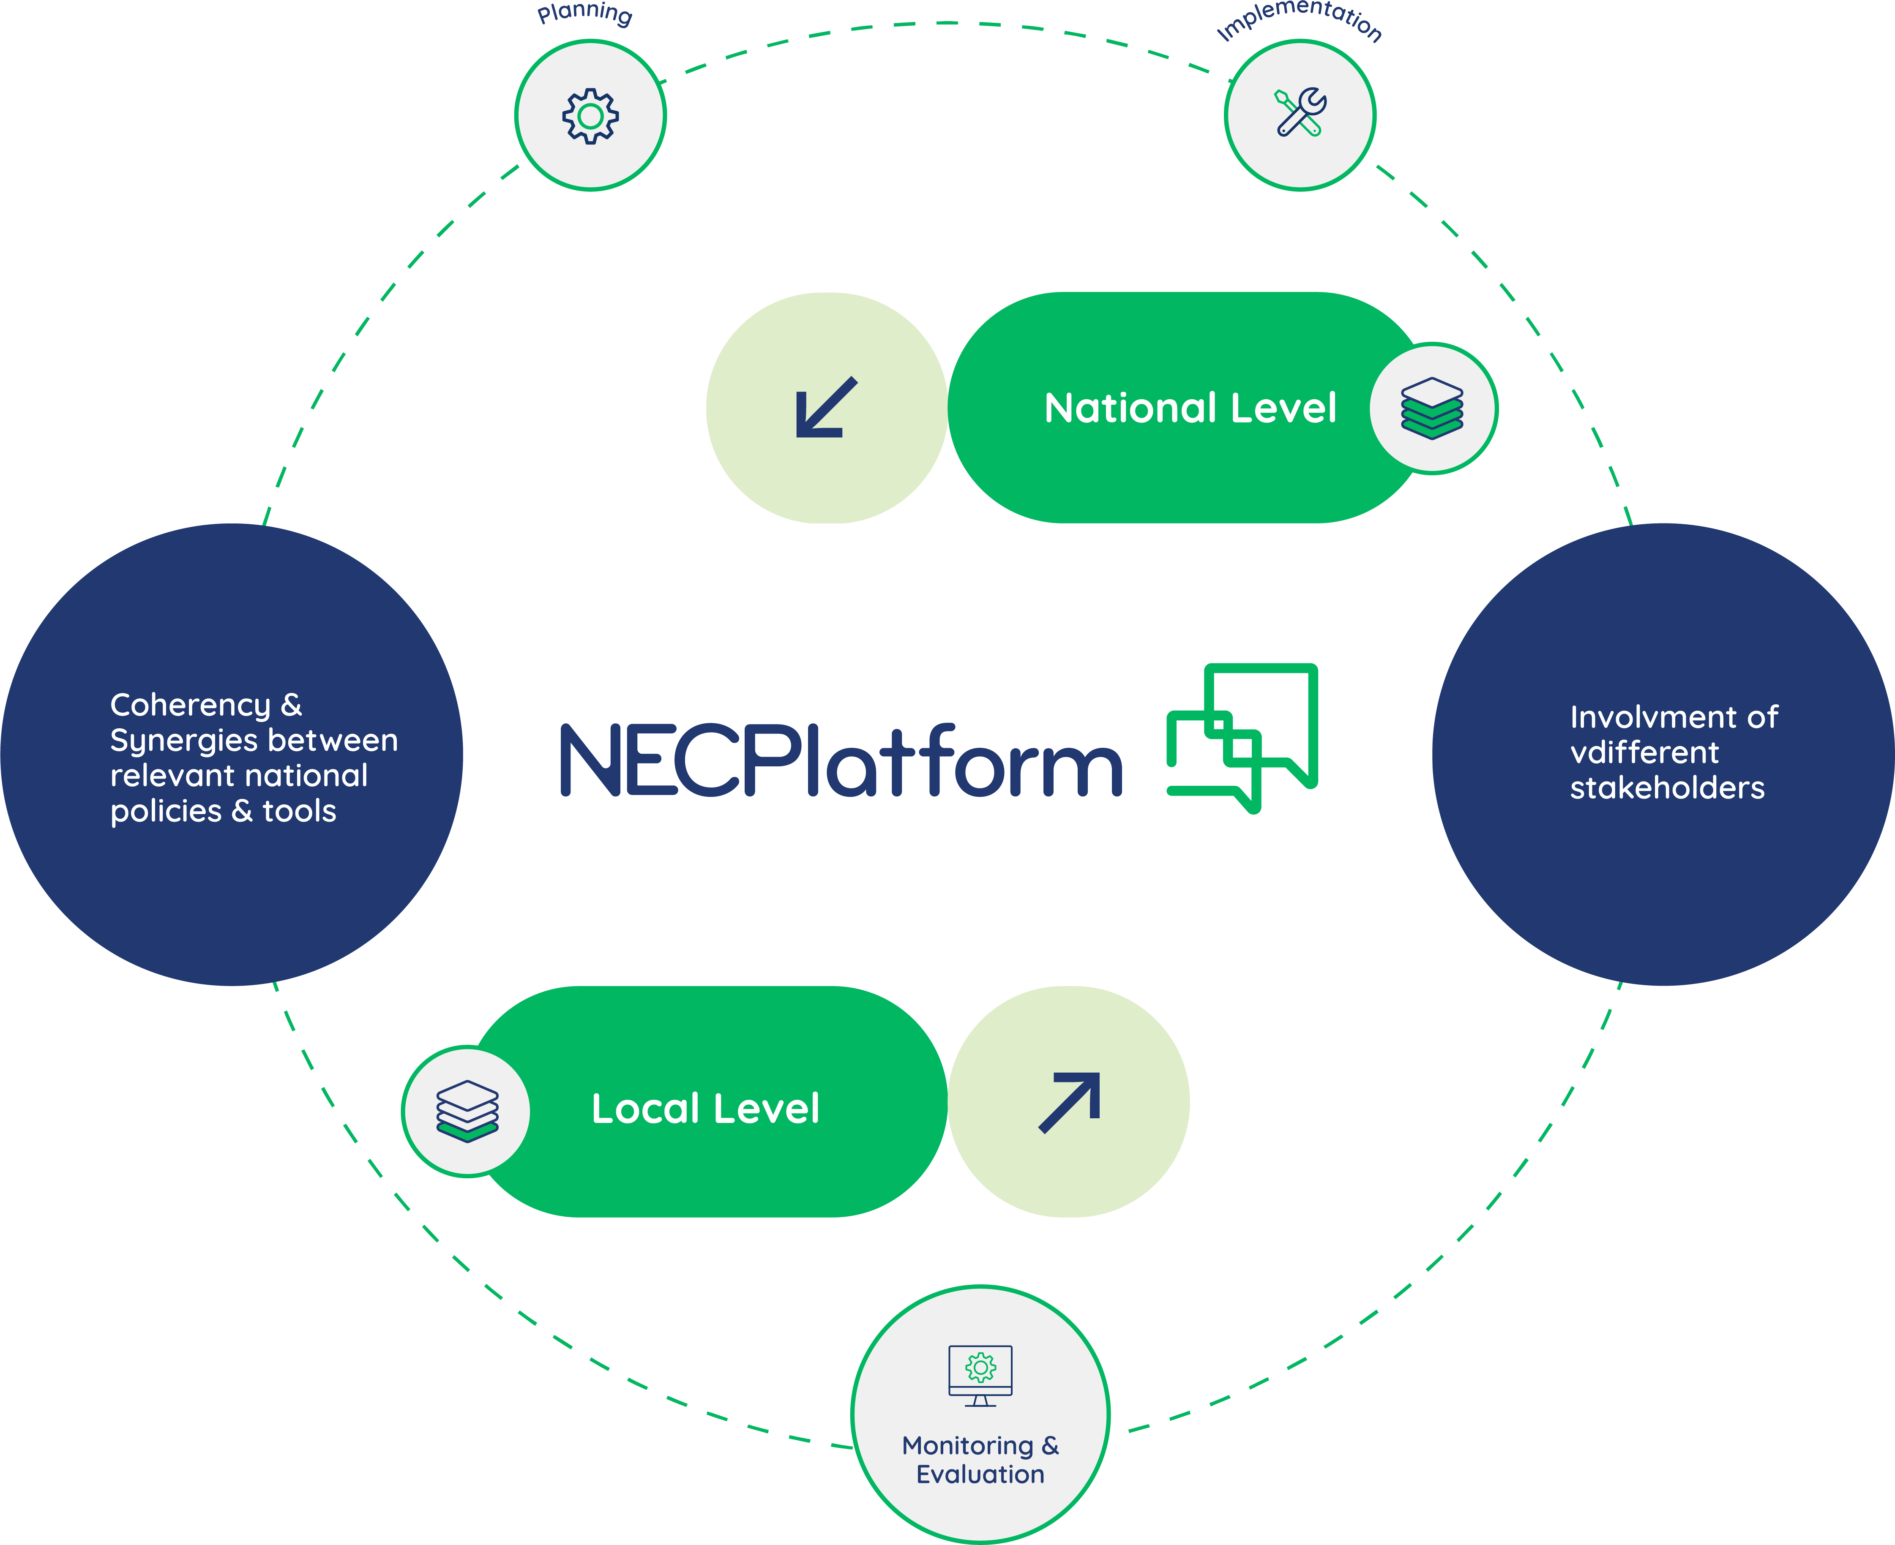
Multi-level governance facilitated at different stages of the policy cycle
Vertical
Integration
Enhance higher-level decisions and align them to sub-national needs;
Horizontal
Integration
Engage peers at the same level to ensure synergies and avoid overlaps
Notes:
MLG - article 11 of the Governance Regulation: permanent multi-level energy dialogue, bringing together local authorities, civil society organisations, the business community, investors and other relevant stakeholders to discuss the different options envisaged for energy and climate policies. It should be possible for the Member State's integrated national energy and climate plan as well as its long-term strategy to be discussed within the framework of that dialogue.
In the latest guidance to MS for the updates of their NECPs, the EC highlighted once again the need to provide a platform “to discuss with stakeholders the different scenarios envisaged for energy and climate policies and achieving the EU’s climate neutrality objective set out in the Climate Law”.

Slide 4




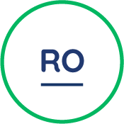

Climate and Energy Dialogue Platforms
NECPlatform will directly support 6 countries in setting up and managing permanent multi- level Climate and Energy Dialogue (CED) Platforms. Such platforms will have the form of roundatables ans will meet six times each.
What for?
Establish and strenghten dialogue between governance levels and relevant stakeholders. Local and Regional authorities play a key role in the energy and climate transition and must be more actively involved from the start.
Support Member States in updating their NECPs: the project is here to support, guide and make it easier for Ministries to do what the EU is asking of them
Facilitate information-sharing and capacity development
Give voices to local and regional authorities on a national level & facilitate vertical and horizontal integration of energy & climate policies

Slide 5
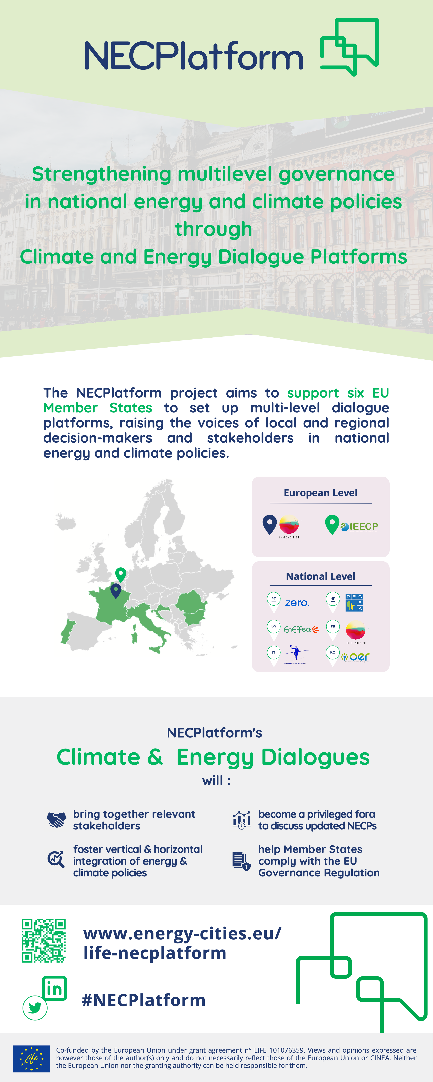




National Energy and Climate Platforms to deliver on the EU 2030 targets
Workshop
Map
Dialogue
Guidelines
Collection & mapping of 21 good MLG practices (including 17 interviews and success factors)
National analysis of local government participation and role in national climate and energy decision-making processes (SWOT analysis)
A manual on “how to set-up and implement multi-level dialogues?”
National state of play including mapping of stakeholders

Slide 6
First round of dialogues
End of May - SOFIA
31/05 - PARIS
03/04 - BOLOGNA
20/04 - BUCHAREST
31/05 - PARIS
17/04 - LISBON

Slide 7
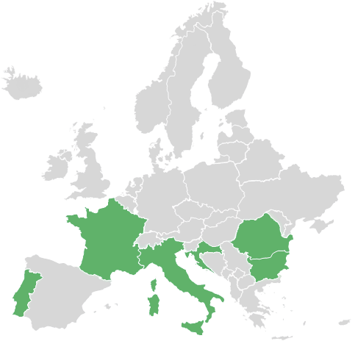
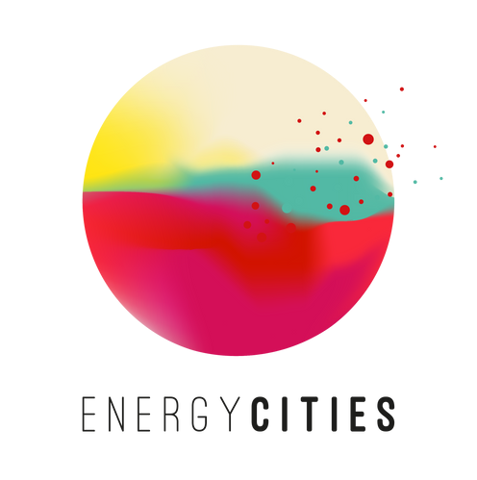
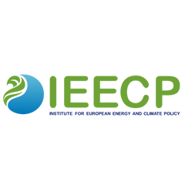









European Level
WHO?
National Level

Slide 8
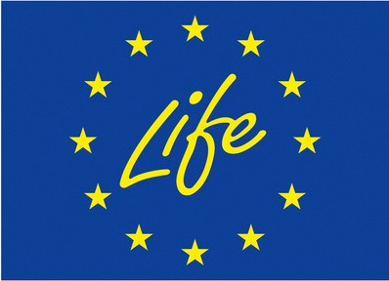
Thank you!
Coordinators:
Thibaut Maraquin |thibaut.maraquin@energy-cities.eu Giulia Pizzini | giulia@ieecp.org
#NECPlatform
www.energy-cities.eu/life-necplatform
Co-funded by the European Union under grant agreement n° LIFE 101076359. Views and opinions expressed are however those of the author(s) only and do not necessarily reflect those of the European Union or CINEA. Neither the European Union nor the granting authority can be held responsible for them.

